Slide 1


ENERGY – THE BASICS
Year 7&8

Slide 2

ENERGY IS ALL AROUND US!
Notes:
Get your students to think of our examples of energy use.

Slide 3

WE USE ENERGY TO WATCH TV
Notes:
Get your students to think of our examples of energy use.

Slide 4
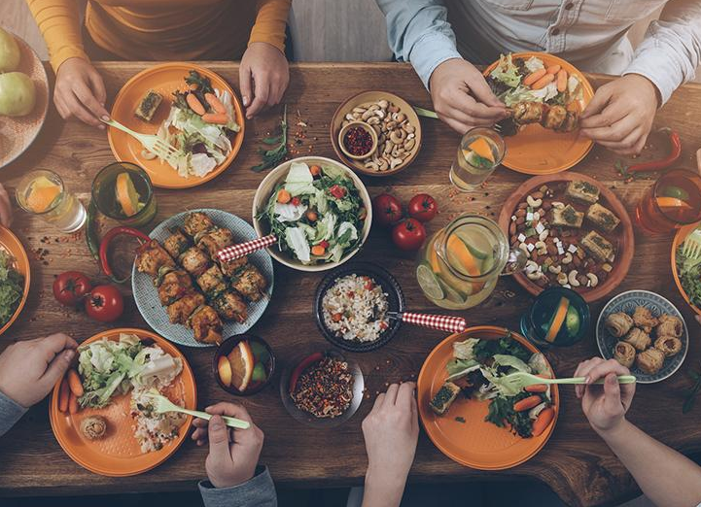
WE USE ENERGY TO DIGEST OUR FOOD
Notes:
Get your students to think of our examples of energy use.

Slide 5
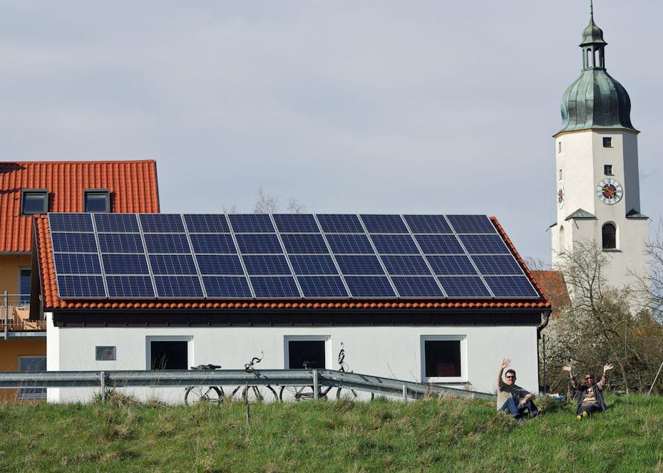
WE USE ENERGY TO LIGHT OUR HOMES
Notes:
Get your students to think of our examples of energy use.

Slide 6

WE USE ENERGY TO CHARGE OUR SMART PHONES
Notes:
Get your students to think of our examples of energy use.

Slide 7
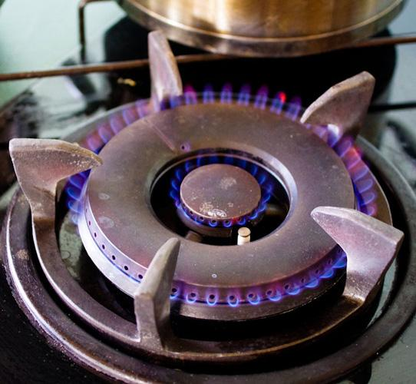
WHAT IS ENERGY?
Notes:
Any changes that the students can see around them is due to energy. Can they think of some changes they have experiences today? (Toast cooking, alarm ringing, bus moving)

Slide 8

IT MAKES CHANGE POSSIBLE!
AND IS DEFINED AS THE CAPACITY TO DO WORK
Notes:
Any changes that the students can see around them is due to energy. Can they think of some changes they have experiences today? (Toast cooking, alarm ringing, bus moving)

Slide 9

DID YOU KNOW?

Slide 10
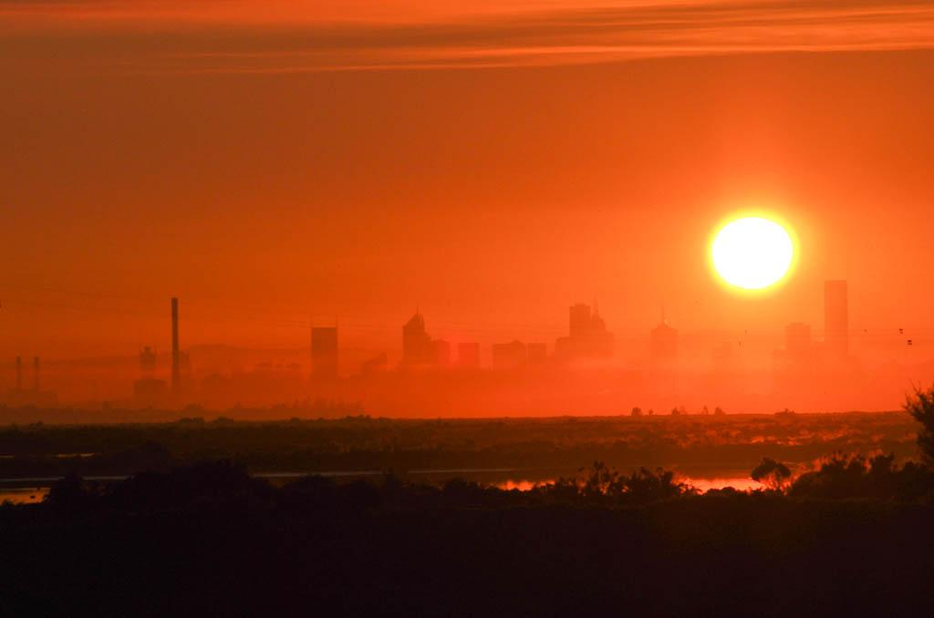
THE SUN IS THE SOURCE OF ALL ENERGY ON EARTH
IT PRODUCES LIGHT AND HEAT

Slide 11
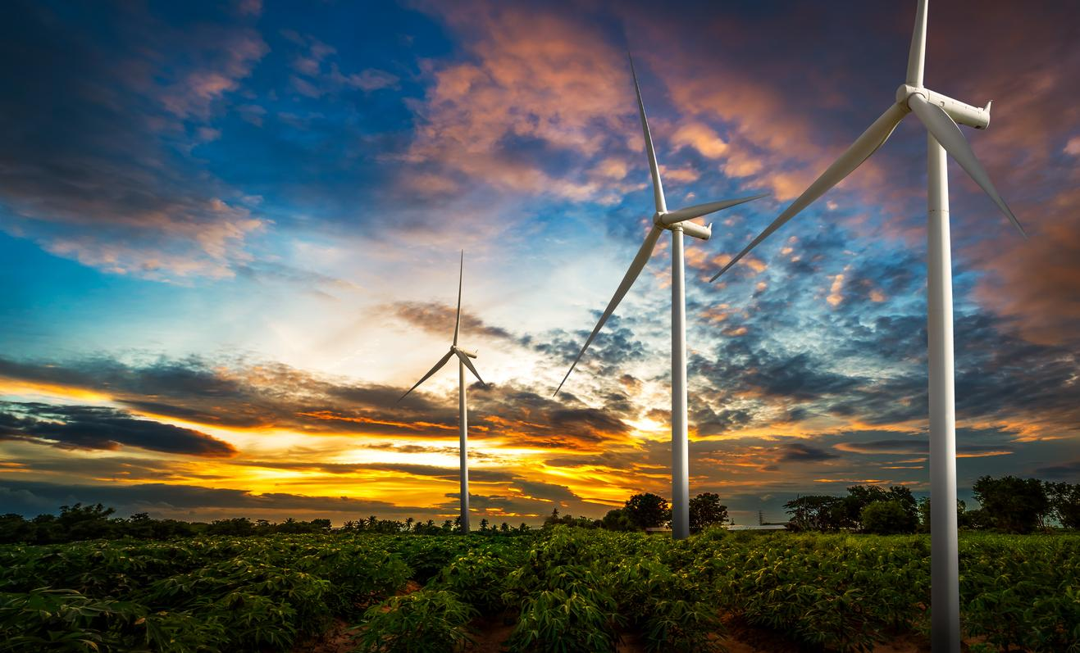
THERE ARE MANY DIFFERENT FORMS OF ENERGY. HOWEVER, OBJECTS HAVE ENERGY EITHER BECAUSE OF…
MOTION (KINETIC) OR
POSITION (POTENTIAL ENERGY).

Slide 12
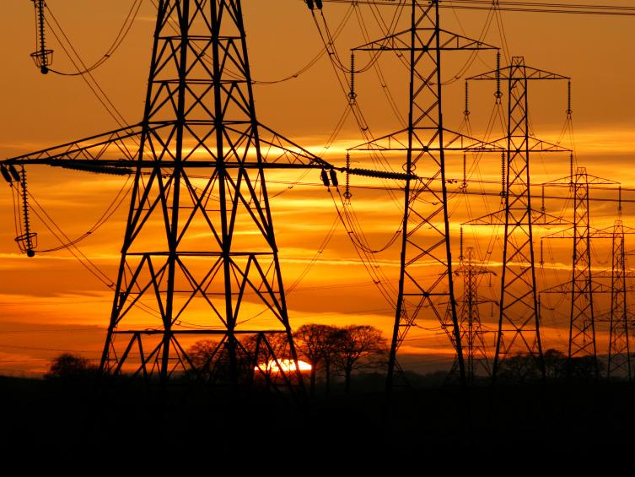
TYPES OF KINETIC ENERGY
MOVEMENT - HEAT & LIGHT - ELECTRICAL

Slide 13
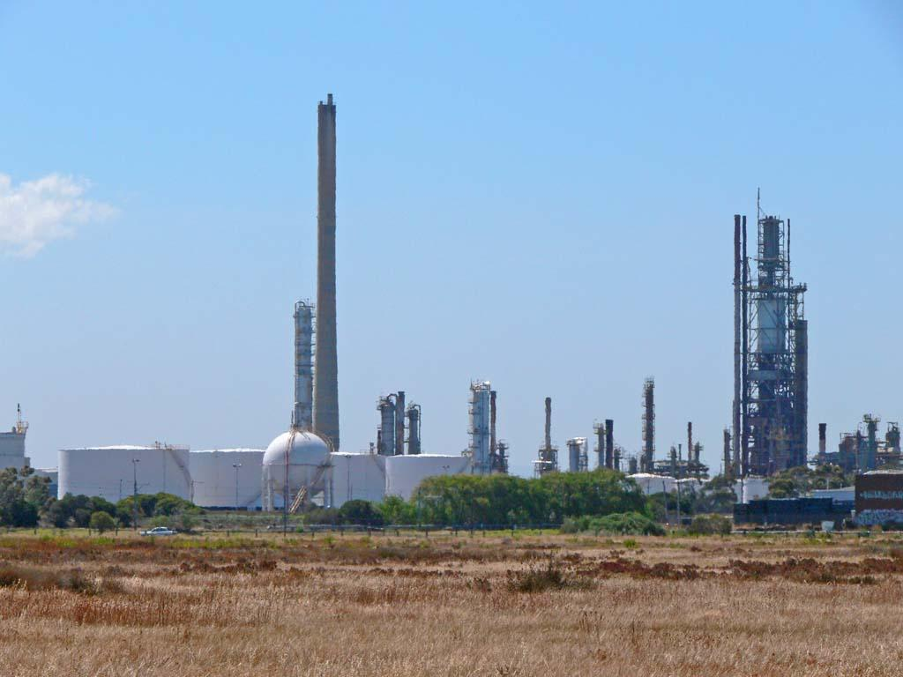
TYPES OF POTENTIAL ENERGY GRAVITATIONAL - CHEMICAL - ELASTIC

Slide 14
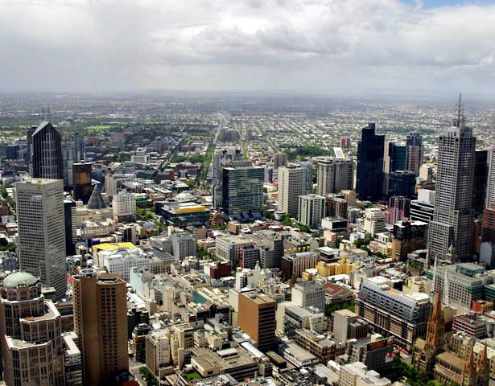
ENERGY IS ESSENTIAL TO LIFE AND ITS CONSERVATION HAS BECOME INCREASINGLY IMPORTANT.
BUT WHERE DOES IT COME FROM AND HOW DOES IT GET INTO OUR HOMES?

Slide 15
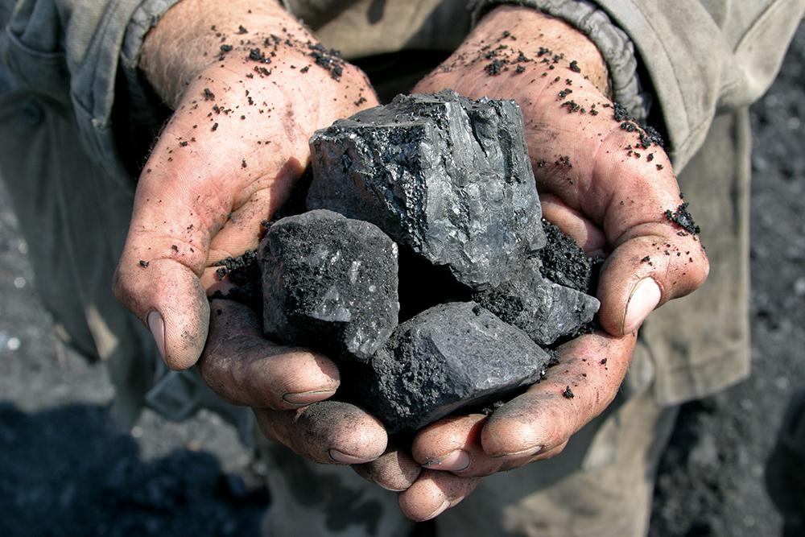
ENERGY SOURCES THE SOURCES OF ENERGY WE USE TODAY CAN BE CONSIDERED:
RENEWABLE – REPLACED BY NATURAL PROCESSES QUICKER THAN THEY ARE BEING USED. E.g. solar, wind
NON-RENEWABLE – ONLY EXIST IN LIMITED DEPOSITS IN VARIOUS PARTS OF THE EARTH. E.g. coal, oil
Notes:
Get your students to sort out the following sources into renewable and non-renewable sources: Coal, Oil, Solar, Wind, Uranium, Wood and Geothermal.

Slide 16
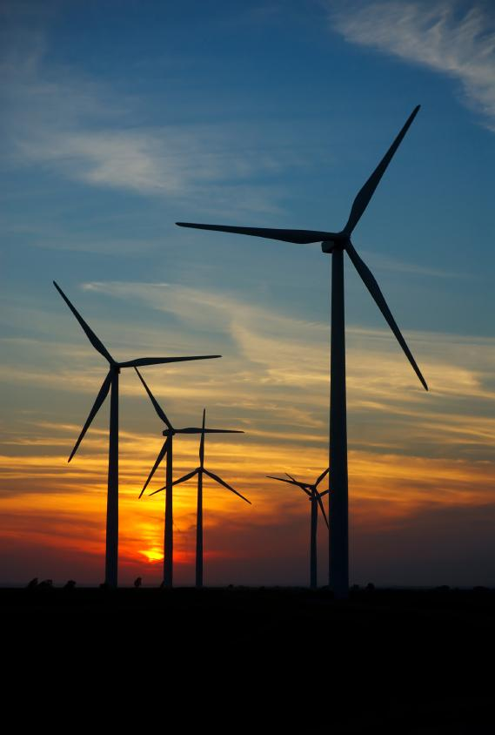
BURNING FOSSIL FUELS IS A MAJOR SOURCE OF GREENHOUSE GASES. INCREASING LEVELS OF GREENHOUSE GASES LEADS TO CLIMATE CHANGE AND GLOBAL WARMING.

Slide 17
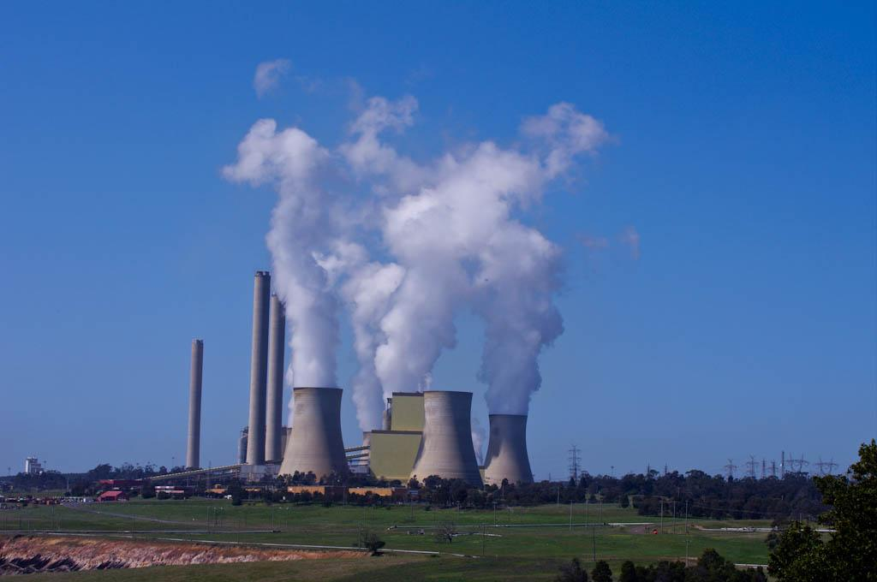
IN AUSTRALIA WE RELY HEAVILY ON NON-RENEWABLE ENERGY, ESPECIALLY COAL.
THIS CREATES A LOT OF GREENHOUSE GASES.
Notes:
Explain to students that coal is a fossil fuel that when burnt produces greenhouse gases.

Slide 18
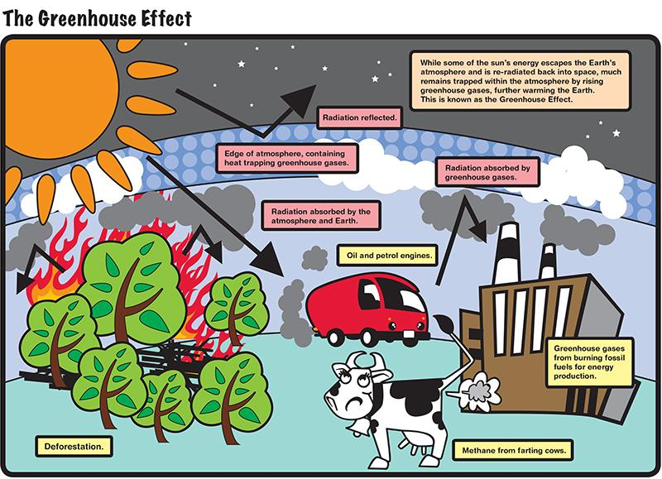
Notes:
You may wish to explain to your students about the enhanced greenhouse effect.

Slide 19
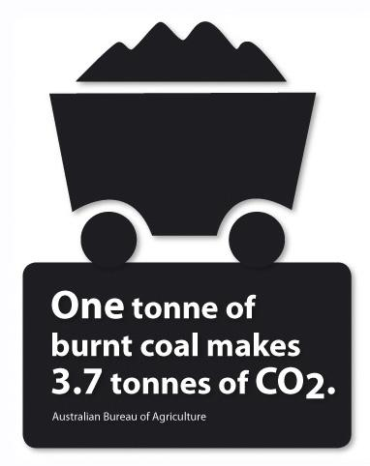
IN AUSTRALIA WE BURN SO MUCH COAL THAT WE CREATE THE MOST AMOUNT OF EMISSIONS PER PERSON OF ANY COUNTRY IN THE WORLD.
WE ARE THE WORLD LEADER IN GREENHOUSE GAS EMISSIONS!
Notes:
Activity: Ask students to write down 5 sentences about how they feel about this shocking fact. Ask each student to share these statements with the class.

Slide 20
DID YOU KNOW?

Slide 21
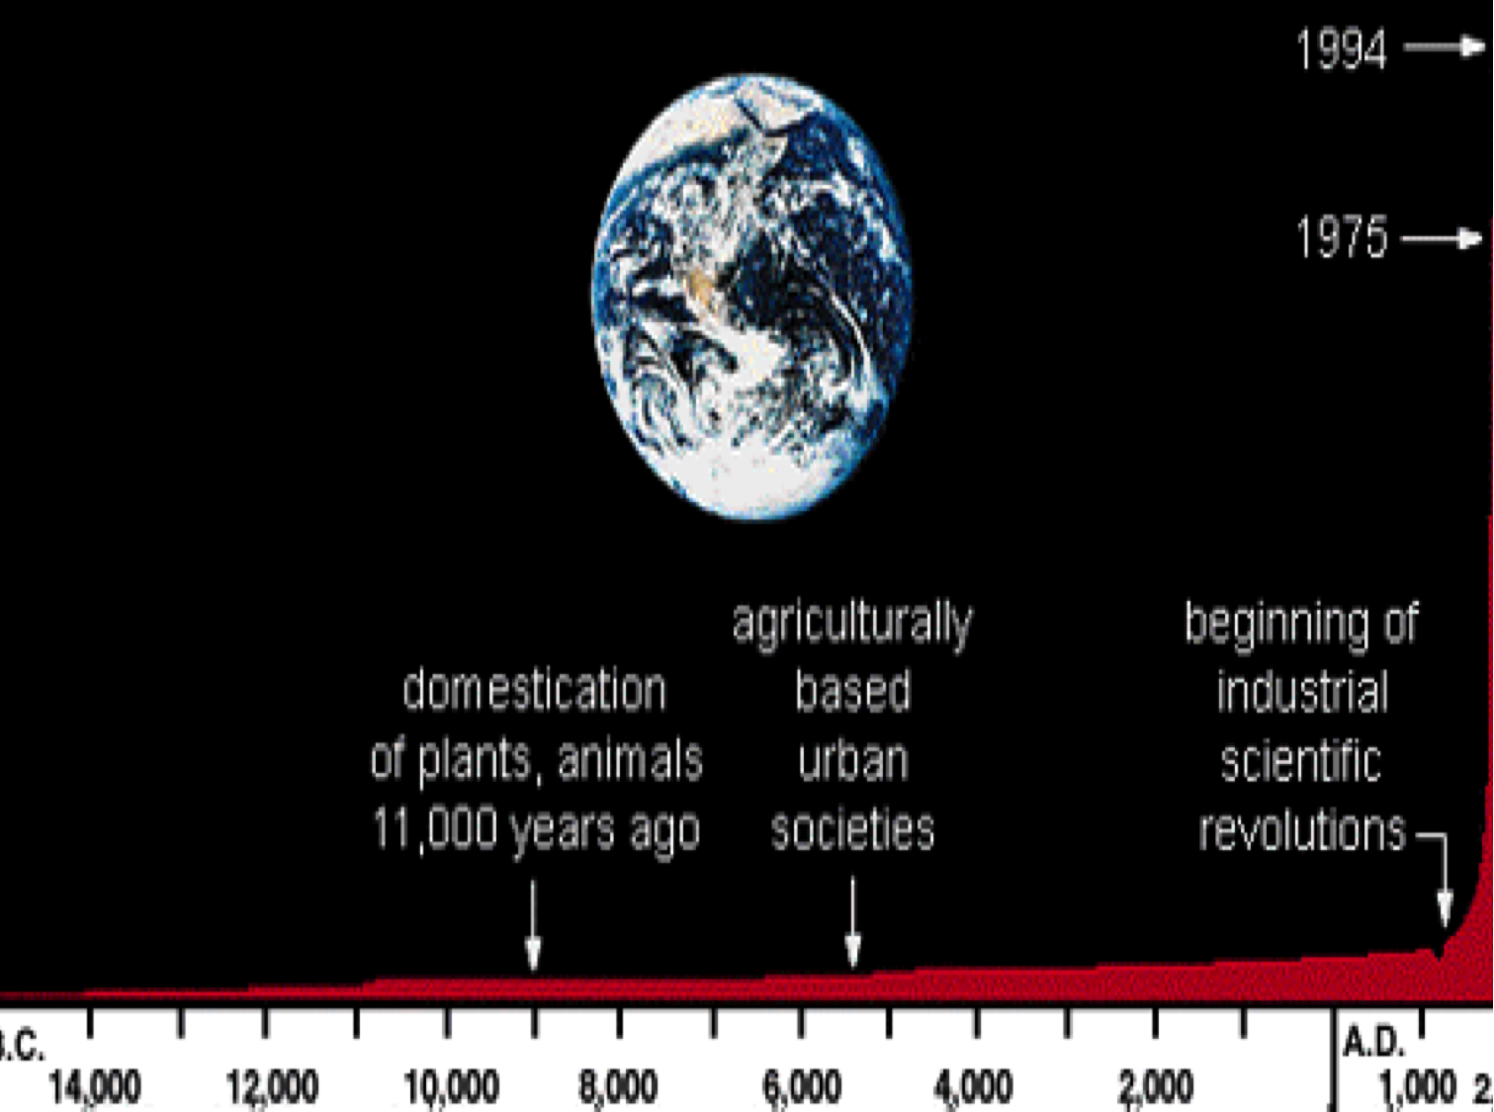
Notes:
What does this mean in terms of energy consumption?

Slide 22
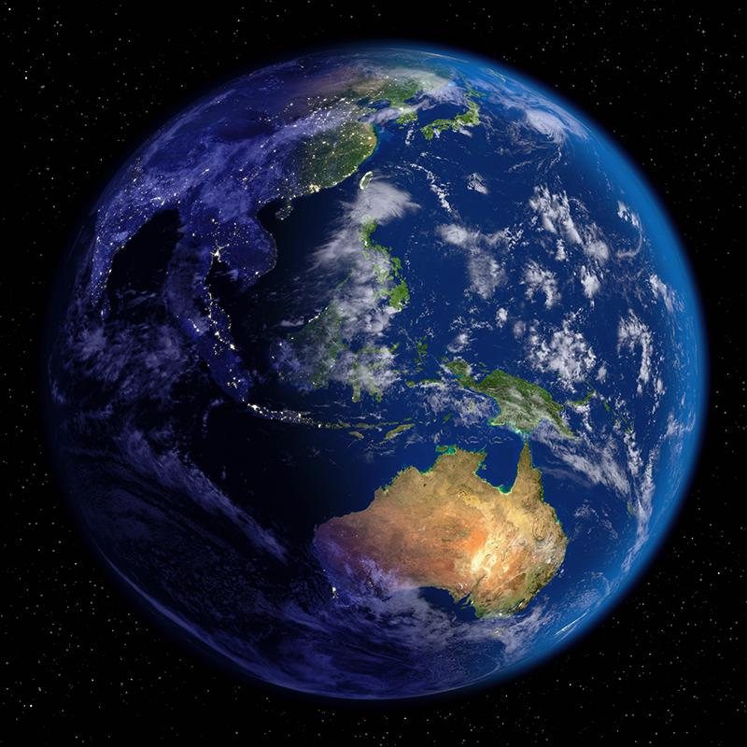
WHAT WILL WE DO WHEN OUR COAL, OIL AND PETROLEUM RUNS OUT?

Slide 23

WHAT ABOUT RENEWABLE ENERGY?
CAN’T WE USE SOME GREEN ENERGY?
LET’S TAKE A LOOK…
Notes:
Activity: What types of green energy can your class think of? Brainstorm as a class.
(solar, wind, geothermal, biomass, hydropower including tidal and wave power, methane capture and conversion)

Slide 24
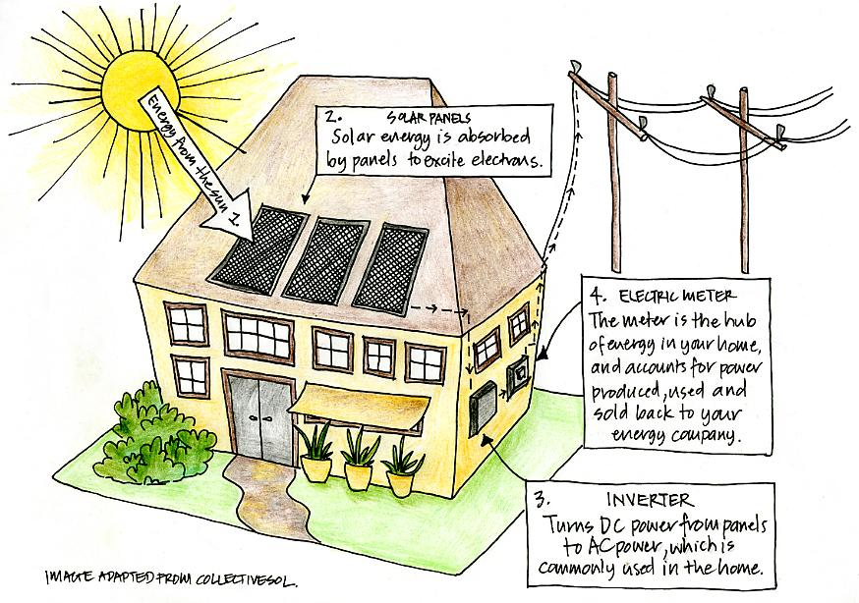
SOLAR POWER CONVERTS SUNLIGHT INTO ELECTRICITY…

Slide 25
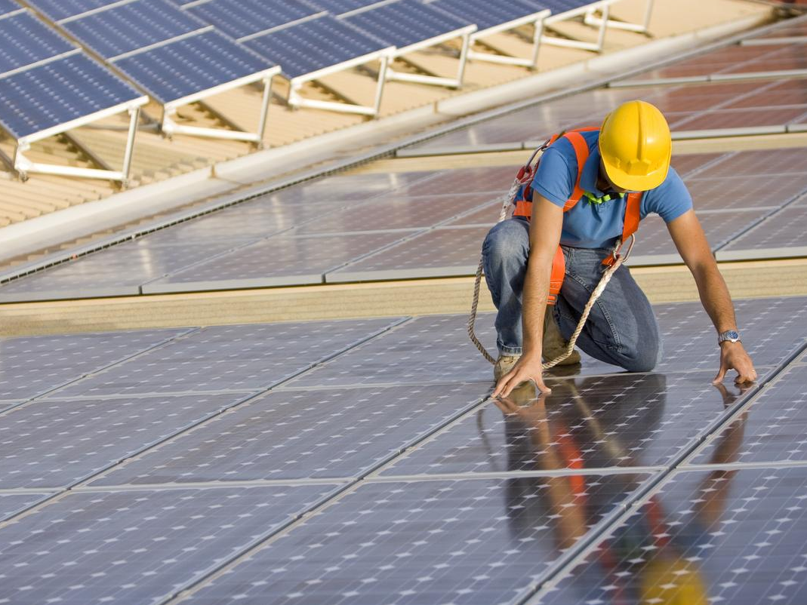
THE AMOUNT OF SOLAR ENERGY THAT HITS AUSTRALIA IN ONE DAY COULD SUPPLY ENERGY FOR THE WHOLE WORLD FOR HALF A YEAR!

Slide 26
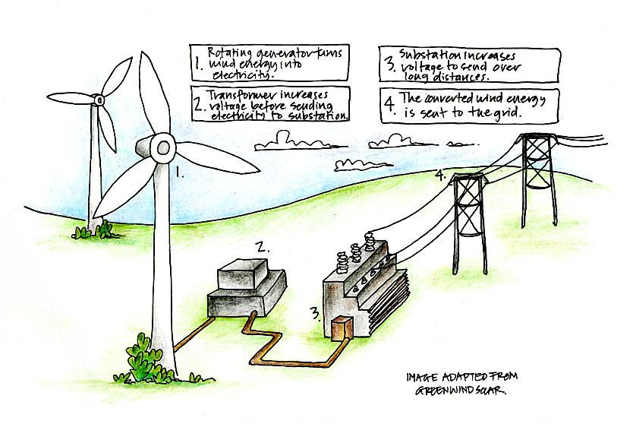
WIND FARMS CONVERT WIND TO ELECTRICITY

Slide 27
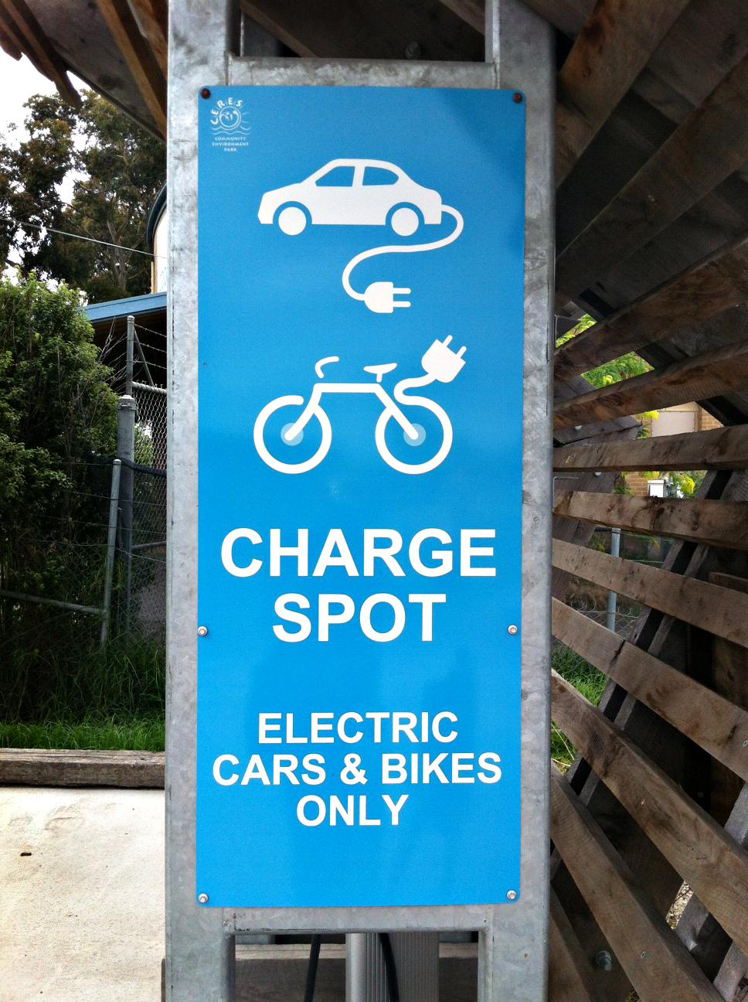
AUSTRALIA HAS THE POTENTIAL TO BE THE WORLD LEADER IN RENEWABLE ENERGY TECHNOLOGIES
Notes:
Activity: Lay it on the line.
Ask your students to think about whether they are for or against wind farms. Draw an imaginary line down one side of the classroom and explain to students that one end of the line represents the opinion “strongly for wind farms” while the other end represents “strongly against wind farms”. Students should stand at the point on the line that represents their views on wind farms. Ask each student to explain their position. If you have time, ask your students to think about how they would negotiate an outcome that everyone was happy with. You could hold a brief debate with students representing the for or against positions.

Slide 28
DID YOU KNOW?

Slide 29
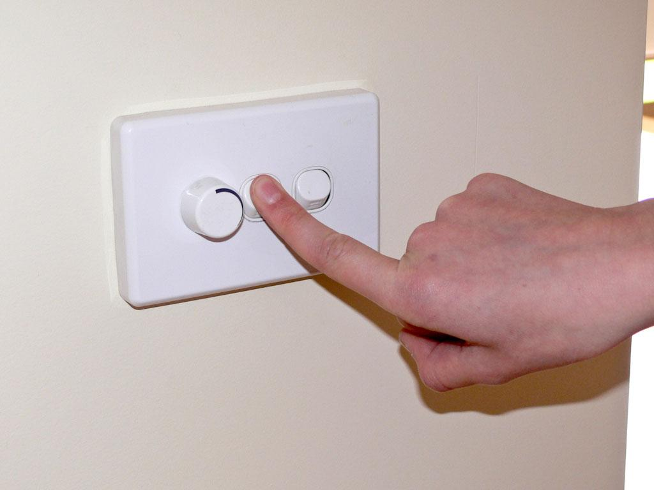
THERE ARE LOTS OF PEOPLE AROUND THE WORLD WORKING HARD TO CREATE NEW TECHNOLOGIES THAT ARE CHEAPER AND EASIER TO USE.
BUT THEY NEED YOUR HELP!

Slide 30
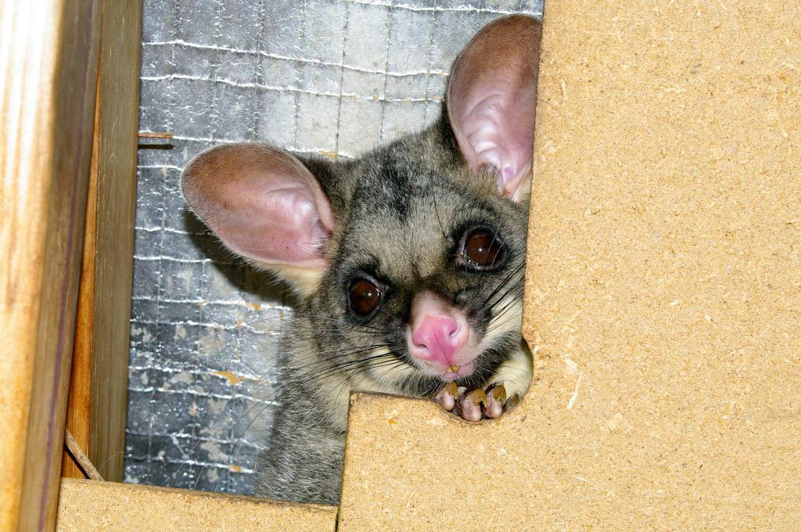
ENERGY SAVING TIPS
TIPS FOR SAVING ENERGY…
CAN YOU THINK OF SOME TIPS?

Slide 31
TIPS FOR SAVING ENERGY…
•TURN OF YOUR LIGHTS WHEN YOU DON’T NEED THEM.
•OPEN THE CURTAINS OR BLINDS INSTEAD OF TURNING THE LIGHTS ON.
•TURN OFF THE STANDBY – THAT LITTLE RED LIGHT ON YOUR STEREO/TV/COMPUTER USES NEARLY 10% OF HOUSEHOLD ENERGY.
•BE SMART WITH YOUR HEATING AND COOLING. TAKE YOUR JUMPER OFF IF YOU’RE HOT BEFORE YOU HIT THE SWITCH ON THE AIR-CONDITIONER, OR PUT ON A JUMPER IF YOU NEED TO WARM UP BEFORE YOU HIT THE SWITCH ON THE HEATER.

Slide 32
TIPS FOR SAVING ENERGY…
DRY YOUR CLOTHES ON THE LINE IN THE SUN AND NOT IN THE DRYER.
HAVE SHORTER SHOWERS. A LOT OF ENERGY IS USED TO MAKE HOT WATER (YOU’LL ALSO BE SAVING WATER). LIKEWISE, WASH YOUR HANDS UNDER THE COLD TAP INSTEAD OF THE HOT.
FOR MORE TIPS AND MORE INFORMATION ON ENERGY VISIT coolaustralia.org

Slide 33
More resources at Cool Australia
For more cool resources head to www.coolaustralia.org to explore over 900 free-to-access, Australian curriculum and EYLF aligned activities, lessons and resources for teachers.
Student can explore videos, news articles, pictures and factsheets in the digital library - www.coolaustralia.org/student-toolbox/

